Slide 1
MOM, I WANT TO CUT MY HAIR
Conversation of mother with son

Slide 2
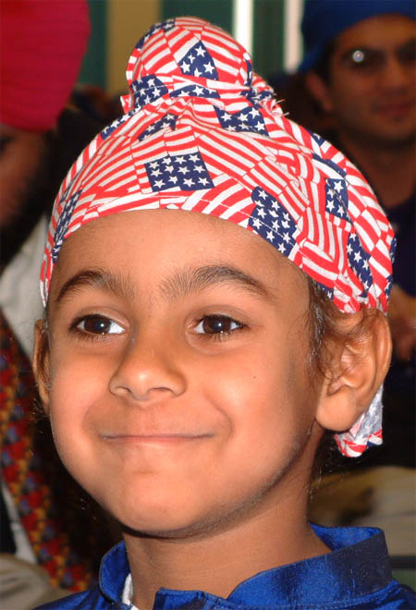
In California, the mother was tired of explaining to her son, day after day, why she wanted him to keep his hair.
Finally, when he asked her, as he did frequently, for permission to cut his hair, she told him to bring the scissors, and that she herself would cut his hair.

Slide 3
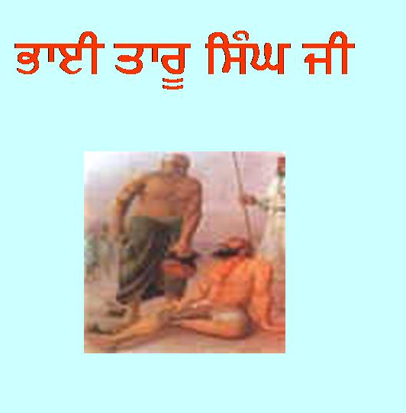
Sikh would rather lose his head than cut his hair
The son was, of course, astonished that she hadn’t told him, as usual, that a Sikh would rather lose his head than cut his hair, a complete silence followed.

Slide 4
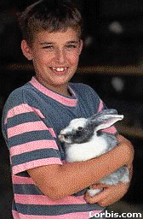
Impossible to change features
After a couple of minutes, his mother reminded him that, although it would be easy to cut his hair, it would be impossible to change his features and the color of his skin.
Consequently, the white Americans, to whom he was apparently trying to conform, would still not accept him fully.

Slide 5
Become superior to them
She told him, “Since you can never be the same as they are, remain what you are, work hard, and become superior to them.”
In this way, the boy was shown that his different appearance made him inferior only if he allowed it to.

Slide 6
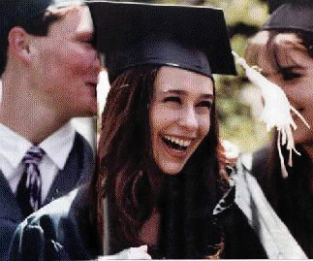
Earn people’s respect.
Therefore, he became determined to earn people’s respect.
He graduated from high school with prizes for both his sports achievements and his academic work.
The white students, whom he wanted to resemble, showed great respect for him and his parents.

Slide 7
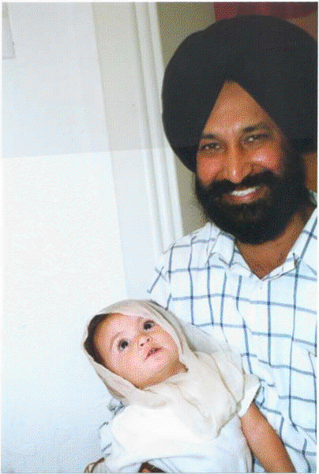
Turban no hindrance in being popular
The boy was later convinced that his turban was no hindrance in being popular with his friends.

